Slide 1

End-to-End Machine Learning System for DDoS Attack Detection Using Random Forest
Department of Artificial Intelligence and Data Science
Team Members:
Nandhakumar A.S
Kathir M
Michel A
Thirugnanam M
Guide:
Mrs. V. Shyamala

Slide 2
Motivation :
DDoS attacks can stop websites and online services.
Traditional security systems cannot detect new attacks properly.
Machine Learning helps identify attack patterns automatically.
This project improves network security using smart detection.
It helps in blocking attackers faster and reducing damage.

Slide 3
Objective / Abstract:
Detect DDoS attacks accurately
Use machine learning for detection
Classify normal and attack traffic
Reduce server downtime

Slide 4
Domain Introduction:
Network Security
Machine Learning
DDoS Attack Detection
Intrusion Detection Systems (IDS)

Slide 5
Literature Survey:
Sawah et al. (2025) - "Distributed denial of service (DDoS) classification based on machine learning"
IJRITCC Authors (2024) - "Utilizing Random Forest for DDoS Attack Detection"
ISI Journal Authors (2024) - "Machine Learning Models for DDoS Detection in Software-Defined Networks"
ScienceDirect Authors (2024) - "Survey and classification of DoS and DDoS attack detection methods using Machine Learning"
ACM DL Authors (2018) - "A Survey of Random Forest Based Methods for Intrusion Detection Systems"
Ezekiel & Taylor (2023) - "A Hybrid Model for APA-DDoS Attacks Using Random Forest with RNN"
Ma et al. (2023) - "Real-Time Detection of DDoS Attacks Based on Random Forest"

Slide 6
Issues / Problem Statement:
DDoS attacks overload servers with malicious traffic, making services unavailable to genuine users.
Existing rule-based security systems cannot detect new or evolving attack patterns.
High false detection rates may block legitimate users.
Manual monitoring and response are slow and inefficient.
Current systems lack automatic and intelligent IP-level blocking.

Slide 7
Existing System & Disadvantages:
Existing System:
Disadvantages:
Existing DDoS detection systems rely on rule-based, signature-based IDS/IPS, and traffic threshold monitoring.
These systems use predefined rules and known attack signatures to identify malicious traffic.
Unable to detect new or unknown (zero-day) DDoS attacks.
High false positive rates may block legitimate users.
Manual response leads to slow mitigation

Slide 8
Proposed Work:
A machine learning–based DDoS detection system is developed using network traffic data.
Network traffic is preprocessed and important features are extracted.
A Random Forest classifier is trained to classify traffic as normal or DDoS.
The system detects attacks in real time and automatically blocks malicious IP addresses.

Slide 9
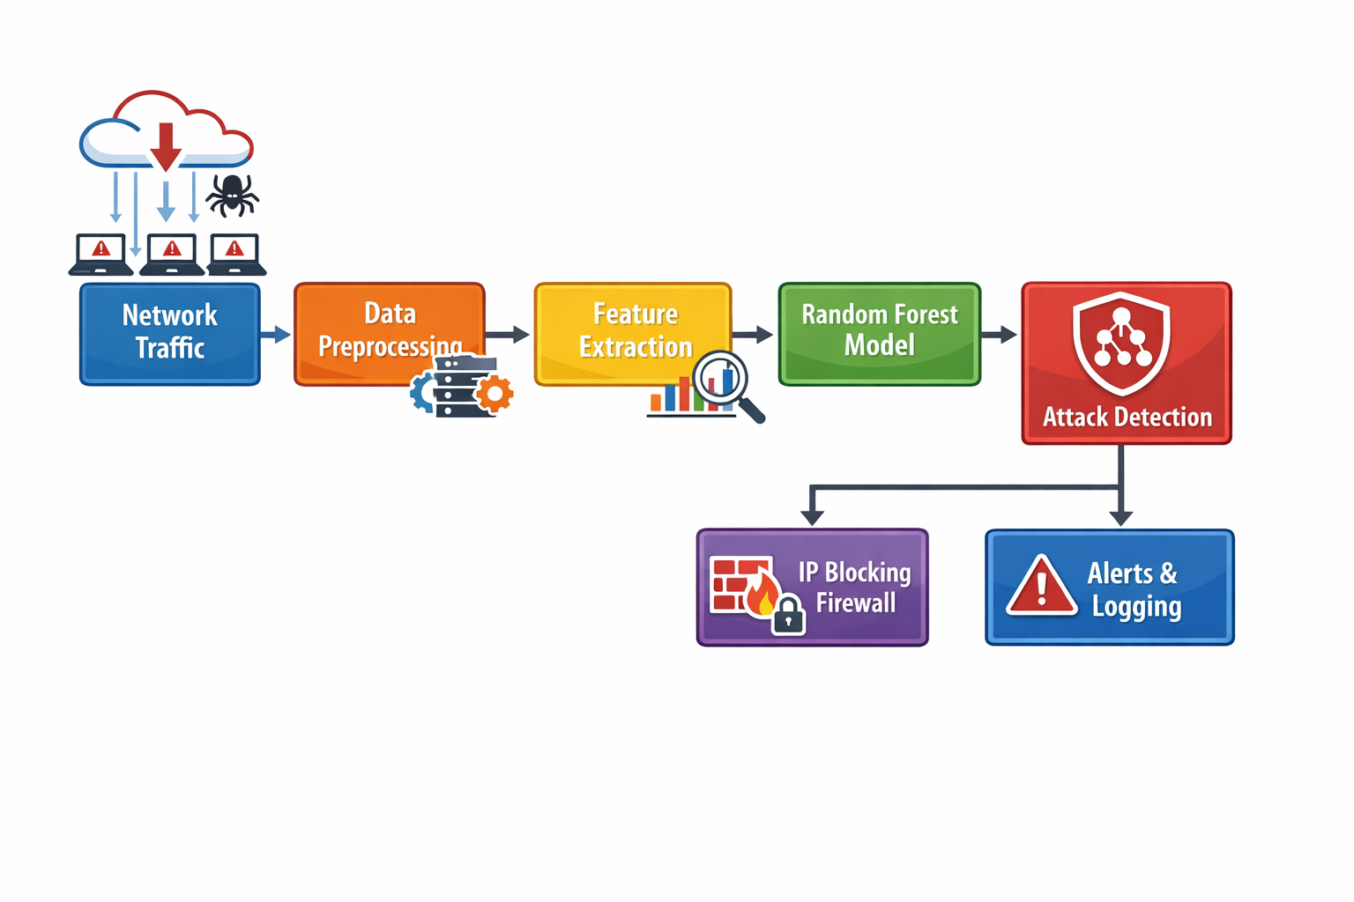
System Architecture:

Slide 10
Methodology:
Collect network traffic data
Preprocess the data
Train ML model
Test with live traffic
Generate alerts

Slide 11
List of Modules:
Traffic Collection Module
Preprocessing Module
Detection Module
IP Blocking Module
Alert & Logging Module

Slide 12
Module Description:
Traffic Collection: Captures data
Preprocessing: Cleans data
Detection: Identifies attacks
IP Blocking: Blocks attackers
Logging: Stores attack details

Slide 13
Software Requirements:
Python
Scikit-learn
Wireshark
Operating System: Windows / Linux

Slide 14
Hardware Requirements:
Processor: Intel i5 or above
RAM: 8 GB
Hard Disk: 256 GB
GPU: RTX 3050 (optional)
Network Interface Card

Slide 15
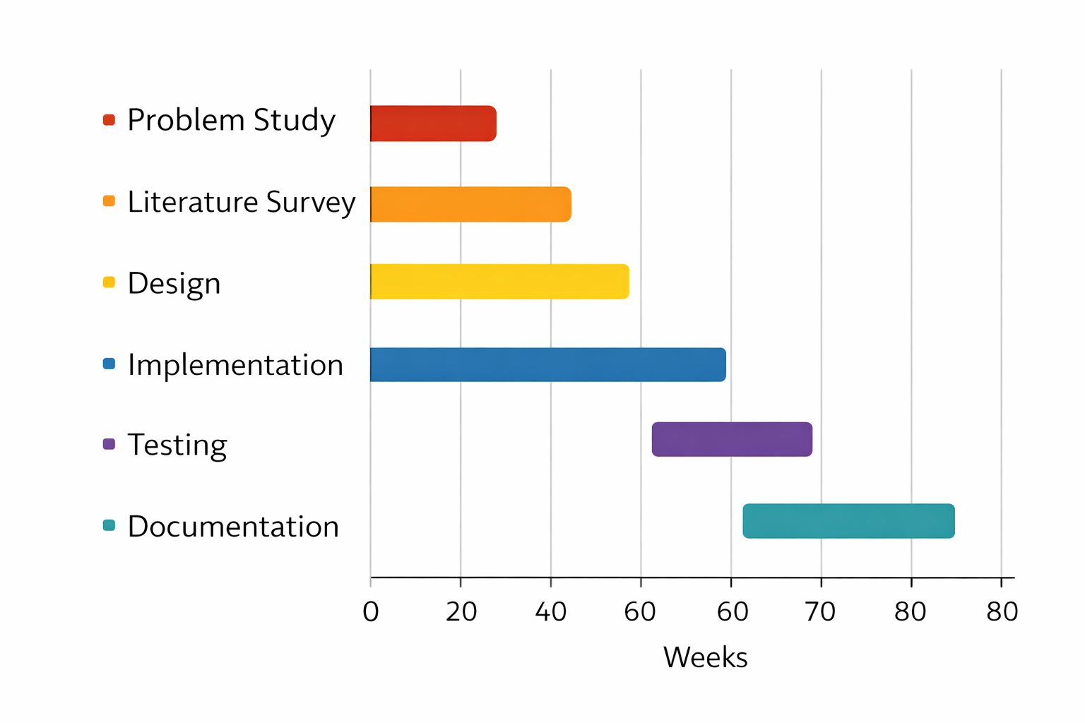
Gantt Chart:

Slide 16
References:
Sawah et al. (2025). "DDoS classification based on machine learning." Scientific Reports, Nature.
Aggarwal et al. (2025). "Optimizing DDoS Attack Detection Using Machine Learning." IEEE.
Fauzia Talpur. “ML-Based Detection of DDoS Attacks Using Evolutionary Algorithms Optimization”.

